Slide 1
School Life Th.L.,,Vasile Alecsandri’’ Scumpia,Moldova

Slide 2
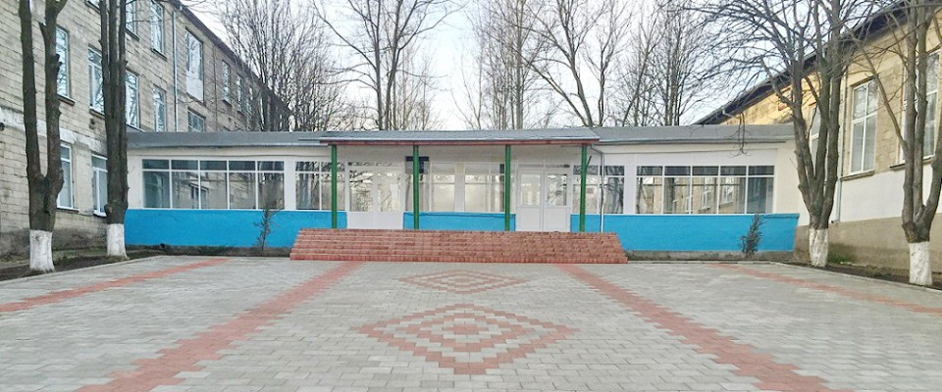
This is Scumpia vilage high school where children come every day from Monday to Friday to study.

Slide 3
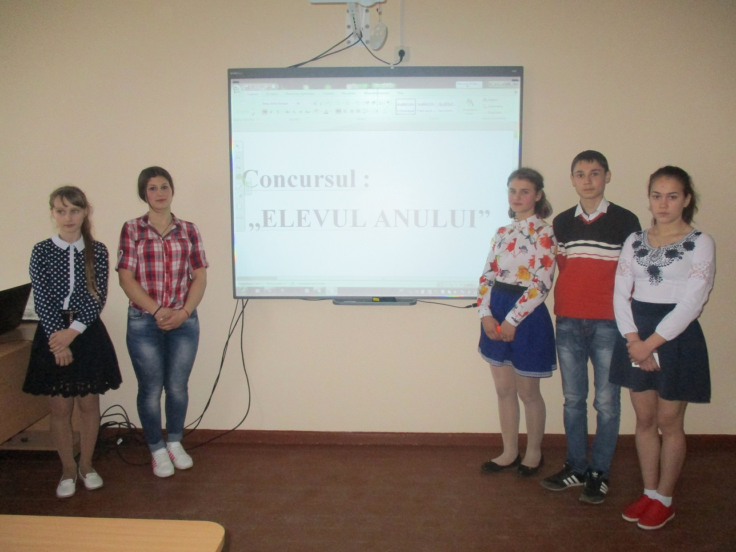
Many extracurricular activities are realized in our school such as:
-The student of the year 2016-2017:

Slide 4
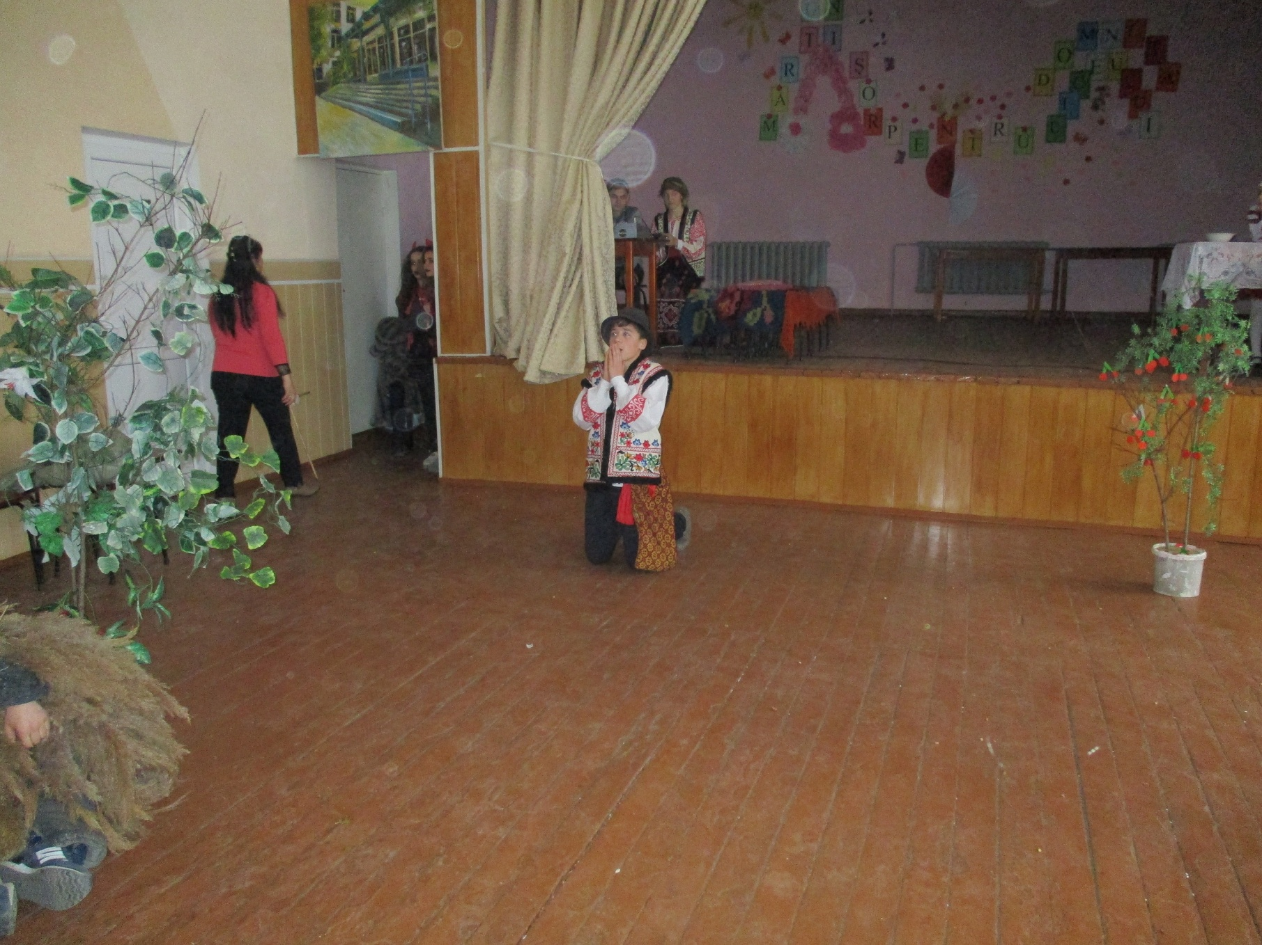
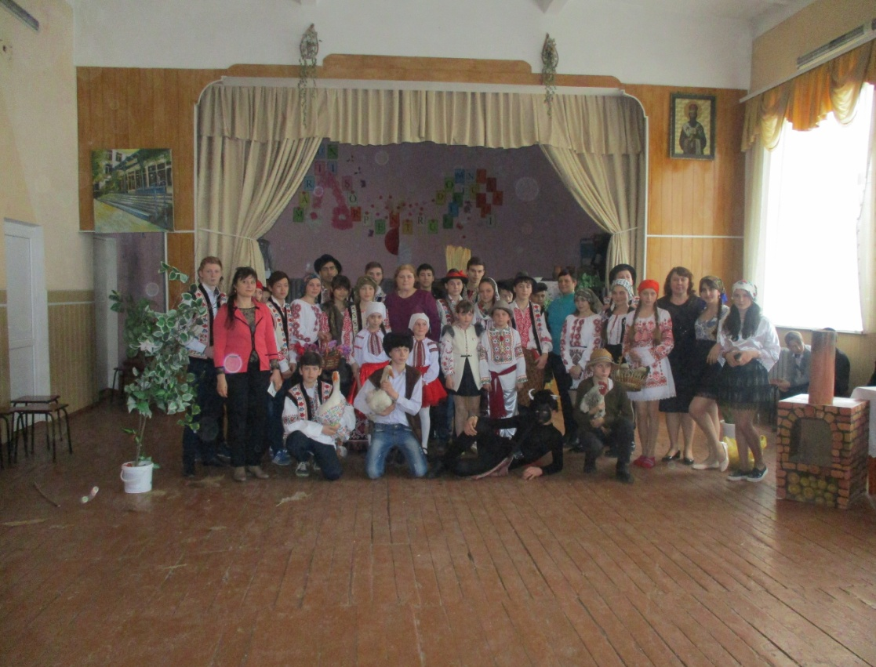
„Dănilă Prepeleac” On 03.16.2017, within L.T. "Vasile Alecsandri" was staged story of Ion Creangă "Dănilă Prepeleac" which had the objective of promoting the creation and exploitation acting talents.

Slide 5
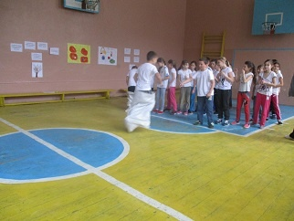
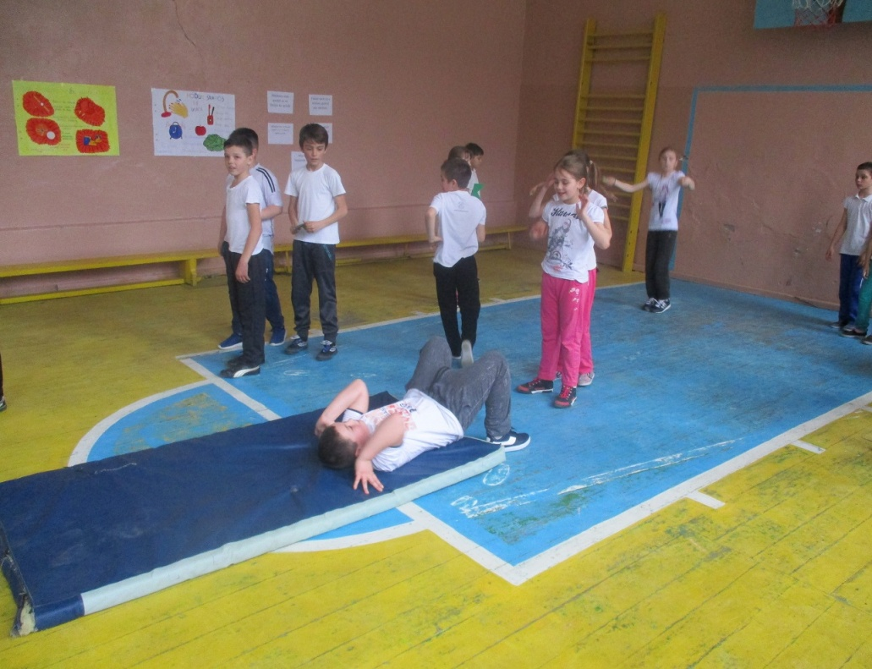
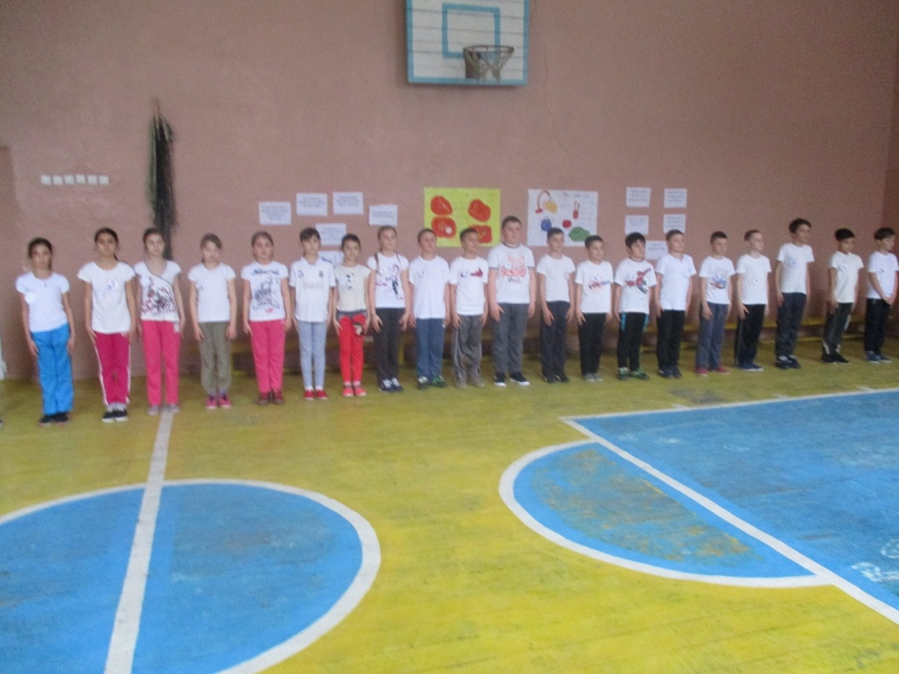
,,Sport race and games’’

Slide 6
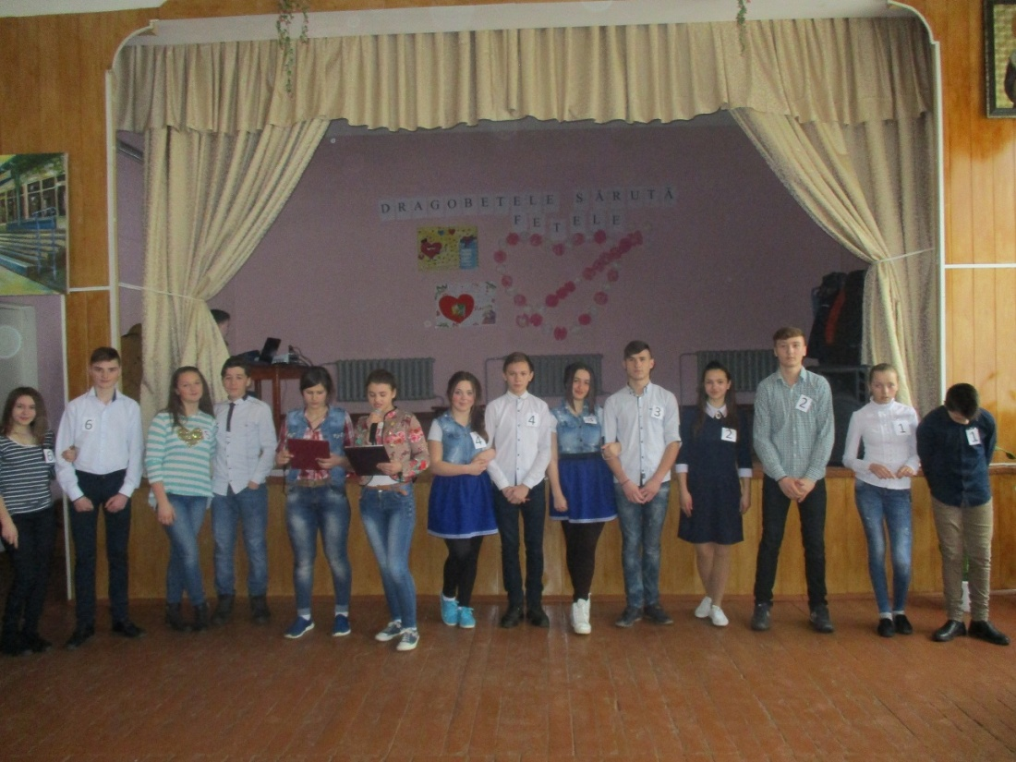
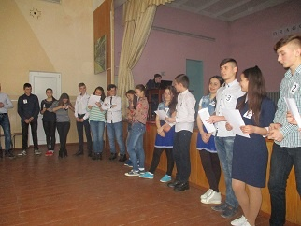
,, Dragobetele kisses the girls "

Slide 7
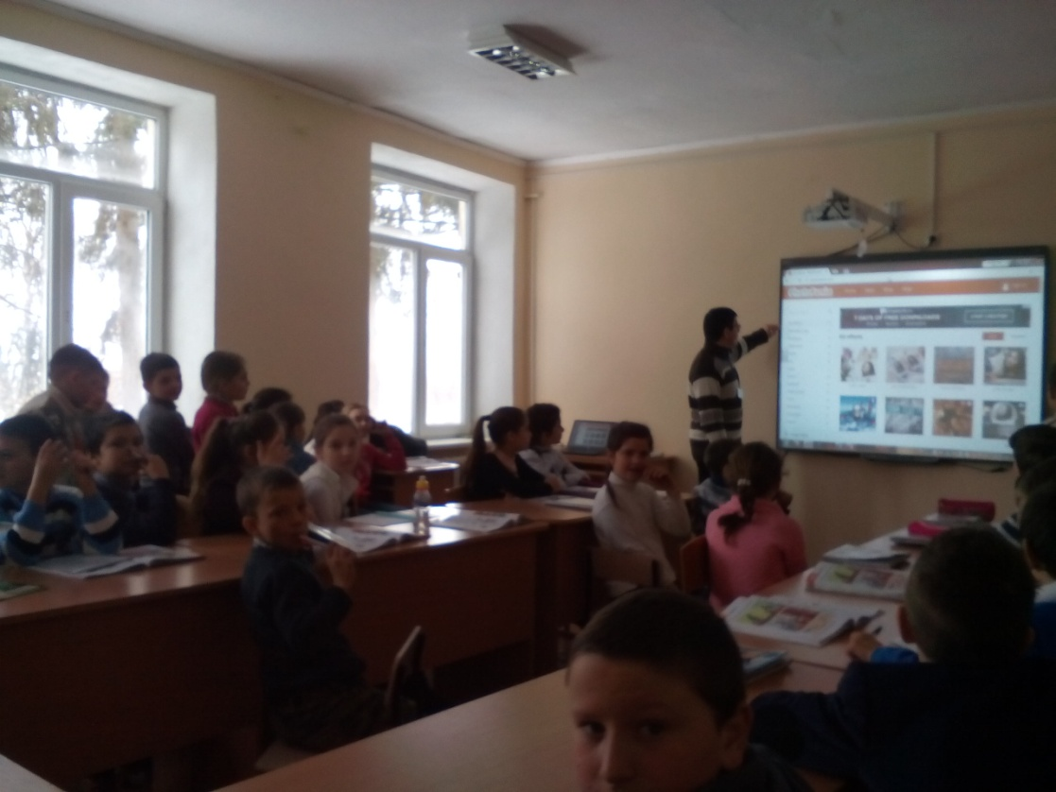
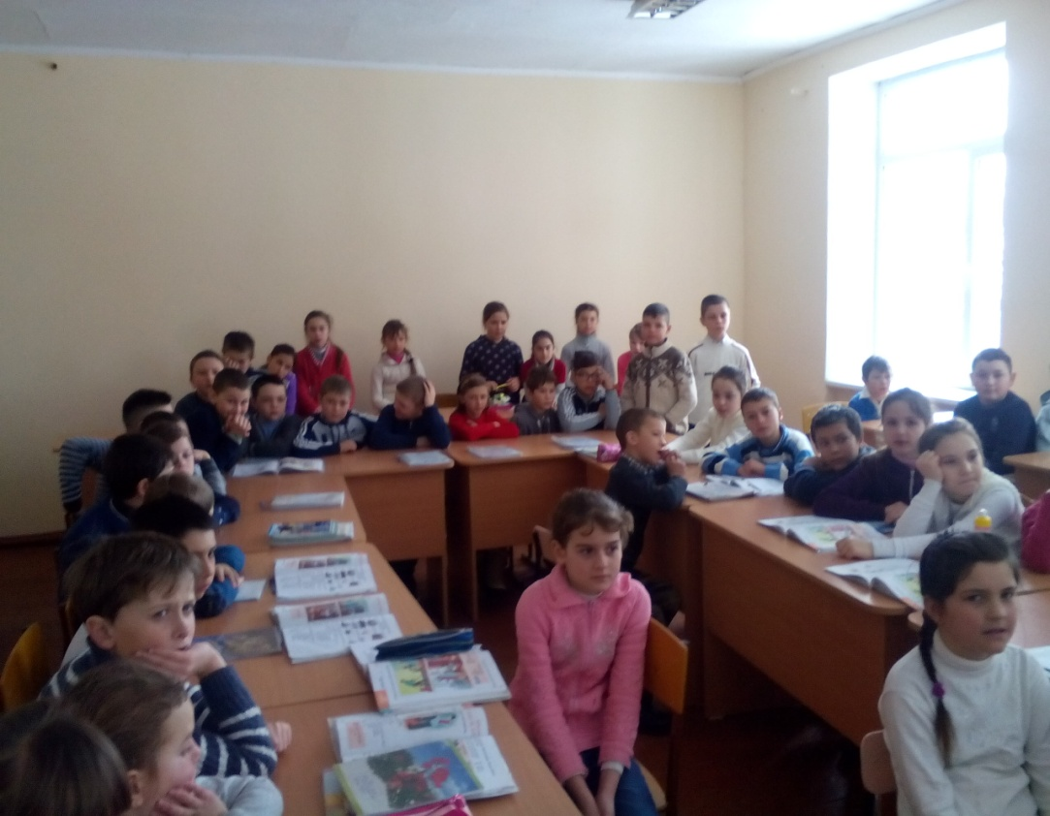
English week online. 13-17 february 2017
During the week of English, students were encouraged to make posters online, online cards dedicated to loved ones and participate in the contest dedicated to English and American culture.

Slide 8
Thank you for watching
Make by : Gheorghita Victor and Gorea Alex

